Slide 1
Team 522 – Rockwell Automation Manufacturing Device for Students
Luis Garcia, Caleb Mears, Maria Rojas, Chloe Keiran, Caden Schwartz, Mark Hanna

Slide 2
Team Introductions
Luis Garcia
Systems/
Dynamics
Engineer
Caleb Mears
Manufacturing
Engineer
Maria Rojas
Test Engineer
Chloe Keiran
Design
Engineer
Caden Schwartz
Electrical Systems Engineer
Mark Hanna
Computer/
Software
Engineer

Slide 3
Sponsor and Advisor
Industry Sponsor
Tajaey Young
Rockwell Automation
Industry Sponsor
Amanda Eason
Rockwell Automation
Academic Advisor
Shayne McConomy, Ph.D.
Professor/Advisor

Slide 4
Objective
The objective of this project is to create a system that can demonstrate the automated manufacturing process and create an educational item.

Slide 5
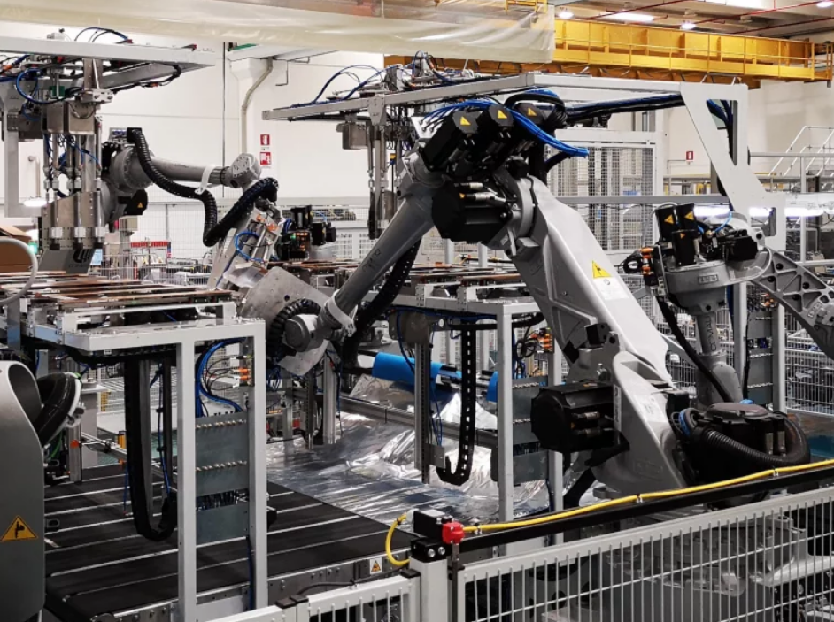
Project Background
Rockwell Automation is interested in engaging wider demographics on automated manufacturing.
Key Goals
Simulate automated manufacturing process
Provide educational experience
Create
tangible product

Slide 6
Critical Targets and Metrics
Control
Response time:
5 ms
Support
Load capacity:
30 lb/13.6 kg
Cycle time:
<5 min
Quiz Score:
>70%
Manufacture
Educate

Slide 7
Functional Decomposition
FUNCTION | CONTROL | SUPPORT | EDUCATE | MANUFACTURE
Mobile |  | X
Showcase Rockwell Hardware |  | X
Display Manufacturing Process |  | X | X
Reinforcement |  |  | X
Engaging |  |  | X
Receive Raw Materials |  | X | X | X
Manipulate Raw Materials | X |  | X | X
Eject Final Object | X |  | X | X
ROCKWELL AUTOMATED LEARNING TOOL
CONTROL
SUPPORT
EDUCATE
MANUFACTURE

Slide 8
Concept Generation
What is being manufactured?
Research and brainstorming
List of items developed
Five items approved
Engaging items
focused on
Twenty items considered
Feedback from Sponsor
Brainstorming
Crap shoot

Slide 9
Concept Generation
Brainstorming
Crap shoot

Slide 10
High Fidelity Concepts
Metal Pin: A moving assembly system with paper design.
Electronics Kit: Produce puzzle that has a functional circuit with LED and pushbutton with a rotating bin system (like soup scene in Ratatouille).
Toy Car Kit: Box with chassis, body, engine, transmission, etc. Make a “punch out” model of a car using a press.

Slide 11
Medium Fidelity Concepts
Personalization engraving: templates on a key chain by branding.
Penny smasher: two cylinders that smash penny and one has different templates with a motor.
Metal Pin: assembly of top and bottom pins done in an iterative fashion.
Electronics kit: resistor color sorting.
Toy car: chassis, transmission, engine, body (all picked by user).

Slide 12
Binary Pairwise Comparison
Customer Needs
Sections must be mobile
Use Rockwell hardware and software
Engaging and interesting for all ages
Output incorporates and shows Rockwell
Safe for all ages
Moves fast enough to be engaging
Controlled continuous cycle
Easy to assemble
Notes:
Compare customer needs against each other to determine the importance weight factor

Slide 13
Concept Selection
Concept Generation
Binary Pairwise Comparison
House of Quality
Pugh Chart
Analytical Hierarchy Process
Final Selection

Slide 14
House of Quality
Customer Needs
Engineering Requirements
Receive information from sensors
Analyze and compute data
Send instruction to output device
Quality check
Maintains rigidity
Maintains stability
Mobile
Displays manufacturing process
Reinforcement
Engaging
Manufacture
Sections must be mobile
Use Rockwell hardware and software
Engaging and interesting for all ages
Output incorporates and shows Rockwell
Safe for all ages
Moves fast enough to be engaging
Controlled continuous cycle
Easy to assemble

Slide 15
Pugh Chart
Critical Engineering Requirements
Design Concepts
Receive information from sensors
Quality check
Maintains stability
Displays manufacturing process
Engaging
Metal pin with paper
Electronics kit: puzzle
Toy car kit: punch out
Personal engraving: key chain
Penny smasher
Metal pin: Rhythmic
Electronics kit: resistor sorting
Toy car: Picked by user
Toy Car: Picked by user

Slide 16
Pugh Chart
Critical Engineering Requirements
Design Concepts
Receive information from sensors
Quality check
Maintains stability
Displays manufacturing process
Engaging
Metal pin with paper
Electronics kit: puzzle
Toy car kit: punch out
Personal engraving: key chain
Penny smasher
Metal pin: Rhythmic
Electronics kit: resistor sorting
Datum
Rockwell Dream Machine
Toy Car: Picked by user

Slide 17
Pugh Chart
Critical Engineering Requirements
Design Concepts
Receive information from sensors
Quality check
Maintains stability
Displays manufacturing process
Engaging
Metal pin with paper
Electronics kit: puzzle
Toy car kit: punch out
Personal engraving: key chain
Penny smasher
Metal pin: Rhythmic
Electronics kit: resistor sorting
Datum
Toy Car: Picked by user

Slide 18
Analytical Hierarchy Process: AHP
Critical Engineering Requirements
Displays manufacturing process
Engaging
Maintains stability
Quality check
Receive information from sensors
Notes:
Compare critical eng req to get criteria weights

Slide 19
Final Selection
Metal Pin
Highest alternative value
Most plausible within given timeline
Satisfies customer requirements

Slide 20
Future Work
Design prototype/
System Modeling
Material Selection/
Bill of Materials
Final Prototype/Risk Analysis
Virtual prototype/physical model

Slide 21
Thank you When you invest in Team 522 solutions, you invest in the future of educational manufacturing.

Slide 22
Binary Pairwise Comparison

Slide 23
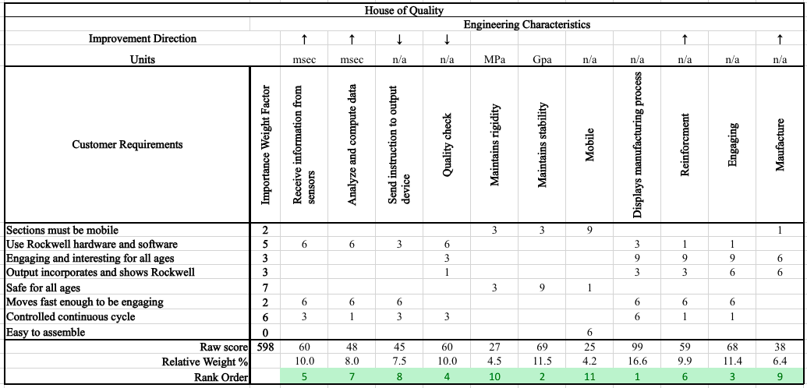
HOQ

Slide 24
Pugh Chart iteration #1

Slide 25
AHP

Slide 26
Pugh Chart Iteration #2

Slide 27
Normalized AHP

Slide 28
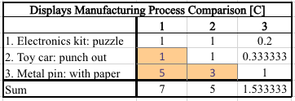
AHP DESIGN ALTERNATIVE - "Displays Manufacturing Process"

Slide 29
AHP DESIGN ALTERNATIVE - "Displays Manufacturing Process"

Slide 30
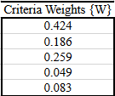
Final Rating Matrix

Slide 31
Final Selection

Slide 32
This is 10-point
This is 15–point Times
This is 20–point
This is 25–point
This is 30–point
This is 35–point
This is 40–point
This is 50–point
This is 60–point
This is 72–point
Notes:
Use at least 20-point font in Room A105, B134, and B136
Use at least 25-point font in Room B135

Slide 33
College of Engineering Color Palette
1 2 3 4
Pantone: PMS 195 C
RGB: 120, 47, 64
Hex: #782F40
CMYK:19, 90, 50, 55
1 2 3 4
Pantone: Black C
RGB: 0, 0, 0
Hex: #000000
CMYK:0, 0, 0, 100
Garnet
Black
1 2 3 4
RGB: 238, 118, 36
Hex: #EE7624
CMYK:2, 66, 99, 0
1 2 3 4
Pantone: PMS 000C
RGB: 255, 255, 255
Hex: #FFFFFF
CMYK: 0, 0, 0, 0
Fang
Orange
White
Notes:
Avoid 75% Black in B135

Slide 34
Accent Color Palette
1 2 3 4
RGB: 0, 59, 111
Hex: #003B6F
CMYK:
1 2 3 4
RGB: 0, 59, 111
Hex: #003B6F
CMYK:
1 2 3 4
RGB: 251, 236, 93
Hex: #FBEC5D
CMYK:
1 2 3 4
RGB: 219, 215, 210
Hex: #DBD7D2
CMYK:
1 2 3 4
RGB: 251, 236, 93
Hex: #FBEC5D
CMYK:
1 2 3 4
RGB: 219, 215, 210
Hex: #DBD7D2
CMYK:
Tardis Blue
Tardis Blue
Corn
Timberwolf
Corn
Timberwolf
1 2 3 4
RGB: 206, 0, 88
Hex: #CE0058
CMYK: 0, 100, 43, 12
1 2 3 4
RGB: 206, 0, 88
Hex: #CE0058
CMYK: 0, 100, 43, 12
1 2 3 4
RGB: 104, 40, 96
Hex: #682860
CMYK:
1 2 3 4
RGB: 220, 220, 220
Hex: #DCDCDC
CMYK:
Rubine Red
Rubine Red
Imperial
Gainsboro
1 2 3 4
RGB: 72, 146, 155
Hex: #48929b
CMYK:
1 2 3 4
RGB: 64, 224, 208
Hex: #40E0D0
CMYK:
1 2 3 4
RGB: 255, 139, 0
Hex: #FF8B00
CMYK:
Asagi-iro
Turquoise
American Orange
Notes:
Remove American orange add hyperlink grey
Make corn the last for b135
All work in 134 imperial move later
Tardis doesn’t work in b136

Slide 35
F7AB19
D67F15
EE7624
D64615
F73119
Analogous
https://color.adobe.com/create/color-wheel
6E3610
F0A16C
EE7624
6E4931
BASB1C
Monochromatic
A14508
4BED3B
EE7624
250CED
2010A1
Triad
A1470C
FF8C40
EE7624
0098A1
24E2ED
Complementary
28A164
2FED8D
EE7624
0848A1
1871ED
Split Complementary
EDAC2F
3BED93
EE7624
0C6AED
ED2F18
Double Split Complementary
ED660C
C7ED3B
EE7624
0CE1ED
A418ED
Square
BA7E09
87724A
EE7624
60EFCF
09BA61
Compound
AD551A
6E3610
EE7624
FA7625
D46820
Shades
Notes:
These are the variants that work well with Fang Orange. The bolded items show well on the projectors.

Slide 36
85412D
8F3831
782f40
8F3176
792D85
Analogous
https://color.adobe.com/create/color-wheel
C44D69
8E626D
782F40
C48796
451B25
Monochromatic
C43959
78743B
782F40
236178
43A2C4
Triad
C43959
C46078
782F40
25C43D
2F783A
Complementary
93C460
577835
782F40
39C49D
297861
Split Complementary
784435
5A783B
782F40
237860
6E2978
Double Split Complementary
782337
78683b
782F40
237830
293978
Square
AB4D32
DEBAAF
782F40
5D8555
70AB32
Compound
38161E
C44D69
782F40
853447
5E2532
Shades

Slide 37
A105
A105
B135 Stage Left
B135 Stage Right
B136
B134, A105
B135

