Slide 1
Material Handling of Ceramics
VDR4
Team 502: Makada Browne, Erich Noack, Charles Stubbs, Amelia Veith
Notes:
Greet everyone

Slide 2
Team Members
Makada Browne
Erich Noack
Charles Stubbs
Amelia Veith
Facilities Engineer
Design Engineer
Test Engineer
Materials Analysis Engineer
Departments of Mechanical Engineering and Industrial Engineering
Team 502
Notes:
Facilities Engineer – Responsible for planning
Design Engineer – Research and develop ideas for new product
Test Engineer – Responsible for all test planning, conducting and reporting activites
Materials Analysis Engineer– Responsible for material selection and analysis
Industrial Engineering – Makada Browne
Mechanical Engineering – Erich Noack, Charles Stubbs, Amelia Veith

Slide 3
Advisor
Dr. Shayne McConomy
-B.S. Mechanical Engineering, Florida State University, 2004
-M.S. Automotive engineering, Clemson University, 2014
-PhD. Automotive Engineering, Clemson University, 2015
Departments of Mechanical Engineering and Industrial Engineering
Notes:
We would like to thank Dr. McConomy for organizing this project and getting us in touch with Corning.

Slide 4
Sponsor
Tevin Smith
-Process Engineer at Corning
-B.S., Material Engineering, Rensselaer Polytechnic Institute (RPI)
-Point of Contact for Team 502
Alexander Richter
-Sr. Process Engineer at Corning
-PhD. Chemical Engineering NC State
-Point of Contact for Team 502
Departments of Mechanical Engineering and Industrial Engineering
Notes:
We would also to thank our project sponsors with Corning: Tevin Smith and Alexander Richter.

Slide 5
Objective
Propose and develop an alternative solution for successful manipulation of ceramic parts without observed damage
Amelia Veith
Departments of Mechanical Engineering and Industrial Engineering

Slide 6
Ceramic Filters
After the firing process and before the finishing process
Brittle, low impact strength and very thin cell walls
Samples vary in weight and size
7.5 - 15 in.
4 - 17 in.
Amelia Veith
Departments of Mechanical Engineering and Industrial Engineering

Slide 7
Manufacturing Process
Mixing
Cutting
Handling
Extruding
Firing
Finishing
Amelia Veith
Departments of Mechanical Engineering and Industrial Engineering
Notes:
This is the manufacturing process for Corning’s ceramic filters

Slide 8
Key Goals
Eliminate Part Damage
Implementable in Manufacturing
Lean Manufacturing System
Test with Part Samples
Amelia Veith
Departments of Mechanical Engineering and Industrial Engineering
Notes:
Eliminate Part Damage
Implementable in Manufacturing – ideally we would like to create a system that weaves seamlessly into a current manufacturing process
Lean Manufacturing System – In addition to creating something that is implementable in manufacturing we also want our system to demonstrate a lean manufacturing system, meaning it aims to reduce times within the production system
Our final key goal is to test our design with the part samples provided by corning

Slide 9
Targets and Metrics
Part Displacement
Support Part Load
Regulate Pressure
Part Misalignment
Part Orientation
Engagement Time
18 in
Force
90°
1 sec
Pressure
0 in.
18 in
Amelia Veith
Departments of Mechanical Engineering and Industrial Engineering
Notes:
Combining these key goals with the customer needs, we created targets and metrics to measure the success of our design. The first one is part displacement meaning we want to be able to move the part 18 inches horizontally and vertically. Our next metric is the device should be able to carry the payload of a target of up to 40 pounds. While being able to withstand the load is important, it is equally as important that we regulate the pressure exerted on the part as the gripper closes in so we don’t create damage during engagement. Additionally, we created a target for part misalignment, which we want to be 0 mili-inches to prevent slippage. Furthermore, since our parts could be horizontal or vertical we needed to accommodate for both orientations, leading us to create a target of 90 degrees. Although this is a range, the expected orientation will be known for the actual implementation. Our last target ties to our key goal of a lean manufacturing system as we want our engagement time to be 1 second or less.

Slide 10
Medium Fidelity Concepts
Vibration Adhesion Gripper
Tension Cable Gripper
Air Filled Cushion Grippers
Gecko Adhesive Gripper
Amelia Veith
Departments of Mechanical Engineering and Industrial Engineering
Notes:
Keeping these targets in mind, we came up with over 100 concepts. After evaluation of each concept, we separated the best 7 concepts into medium and high fidelity. Here are 4 of our medium fidelity concepts. The first one is a vibration adhesion gripper, where we investigated the plausibility of a newer concept using vibration to engage with a part’s surface. We ultimately ruled this one out due to its limitations when accommodating our vertical case. Our next medium fidelity concept was our flexible membrane gripper where cables would be connected to a central motor and the Cable tension would wrap gripper pads around the part surface. This was ruled out because of slippage and weak gripper strength. Next we have our air filled cushion grippers where the Air filled cushioned bags would sandwich the part​ and an air pump would control the air pressure in cushioned bags​ with parallel points of contact. This was also eliminated due to slippage and predicted regulation difficulty. Our last medium fidelity concept was the gecko adhesive gripper which consisted of flexible Gecko skin inspired dry adhesive​ with Air-filled capsules that mold the gripper to ceramic’s shape​

Slide 11
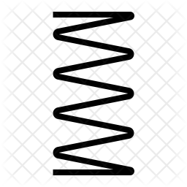
High Fidelity Concepts
Vacuum Suction Grippers
Three Point Gripper
Parallel Sensing Grippers
Amelia Veith
Departments of Mechanical Engineering and Industrial Engineering
Notes:
Moving into our high fidelity concepts, these became our top three concepts. The first one was the vacuum suction gripper, consisting of a vacuum suction array which would be Powered by pneumatics. The second one was a three-point gripper with sensors beneath the padding to regulate the force applied to the part. The third high fidelity concept was the parallel sensing grippers. This design is similar to the three point, but has two finger design with hinged flaps.

Slide 12
Concept Selection
Three Point Gripper
Parallel Sensing Grippers
Vacuum Suction Grippers
​
​
1st
3rd
2nd
Amelia Veith
Departments of Mechanical Engineering and Industrial Engineering
Notes:
After going through concept selection using tools such as the pugh chart, analytical hierarchy process, and house of quality, we arrived at a ranking of our top three concepts; first being the three point sensing gripper, then the parallel sensing gripper, and third the vacuum suction grippers. We decided to move forward with our three point sensing concept and go into 3D modeling

Slide 13
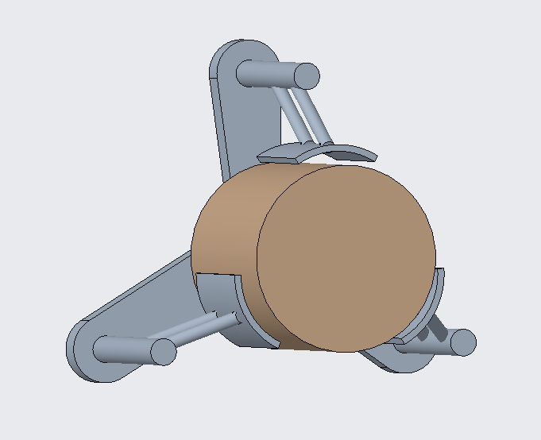
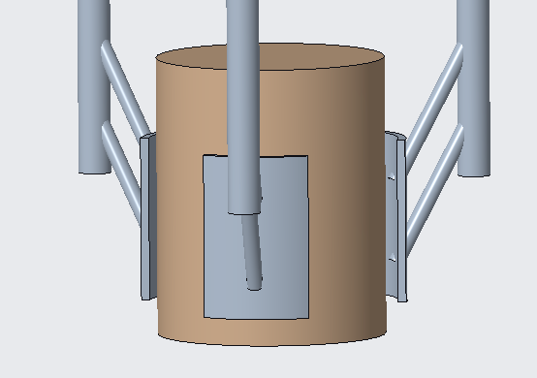
Preliminary Design Configuration
NOT TO SCALE
Charles Stubbs
Departments of Mechanical Engineering and Industrial Engineering
Notes:
Prior to winter break we created a CAD mockup of the concept for the assembly. This was the initial step in more focused design. This initial design includes a parallel linkage for each of the gripper fingers. This allows for a concentric motion with respect to the center of the part. The chassis supporting and connecting these linkages is centered over the face of the ceramic parts. On end of these linkages a pad (or fingertip) is connected to interface with the part and distribute the load, while having cushioning to soften grip forces and improve friction. There would be force sensors on each of the pads That regulate the applied pressure as needed.

Slide 14
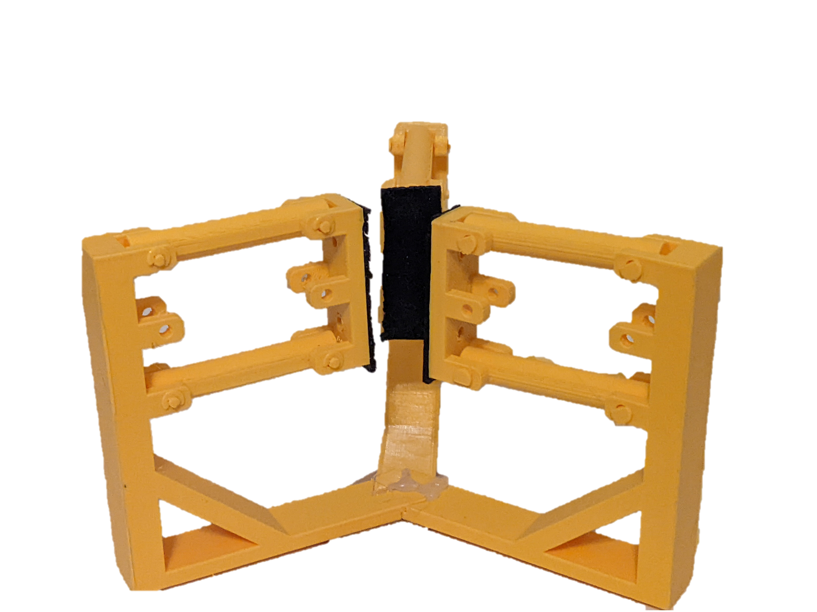
Preliminary Prototype
3D Printed Preliminary Design
Parallel Linkages
Rubber Gripper Padding
NOT TO SCALE
Charles Stubbs
Departments of Mechanical Engineering and Industrial Engineering
Notes:
Taking the mockup we 3d printed a prototype to help frame the system and understand how it would be implemented. This was done with PETG plastic at 1/3 scale and the rubber from under a mousepad on the gripper pads. This represented the state of the design over winter break. The linkages have pins in each joint to permit free motion to demonstrate the kinematics of the mechanism. After playing with the prototype, we found many issues to consider for moving forward. First being the potential issues with clearance for each part orientation. The next being

Slide 15
Design Changes
Sideways chassis design (along the part axis)
Allows unobstructed motion for horizontal loading and unloading
Linear actuators instead of DC motors
Higher static and dynamic force transmission, and easy to control
Multiple Pads included on grippers
Better force distribution and improved surface contact contour
Compression springs and collars to be included
Supports load with compliance and accommodates changing part diameters
Charles Stubbs
Departments of Mechanical Engineering and Industrial Engineering
Notes:
Considering the potential flaws from looking at the prototype, we started to make some morefocused design changes. Some of the changes for the design began with considering how to improve the implementation. We chose to reorient the chassis over the length of the part to improve the approach and reduce the moment created for horizontal cases. We also chose to transition to a mechanism with linear actuators to accomplish that concentric motion from before. These will be capable of supporting higher loads statically and dynamically at the cost of movement time. Our next iteration of design also includes multiple pads for each of the gripper that will try to approach the geometry of the surface of the part. This is very important for force distribution. Matching the contour as much as possible will be an important thing to work on for the final design. There will also be compression springs that will be attached to collars on the grippers’ linear rails. These spring linkages will have adjustable links for different size cylinders and the benefit to the design will be the ability to change the stiffness wrt the compliance desired for the grippers.

Slide 16
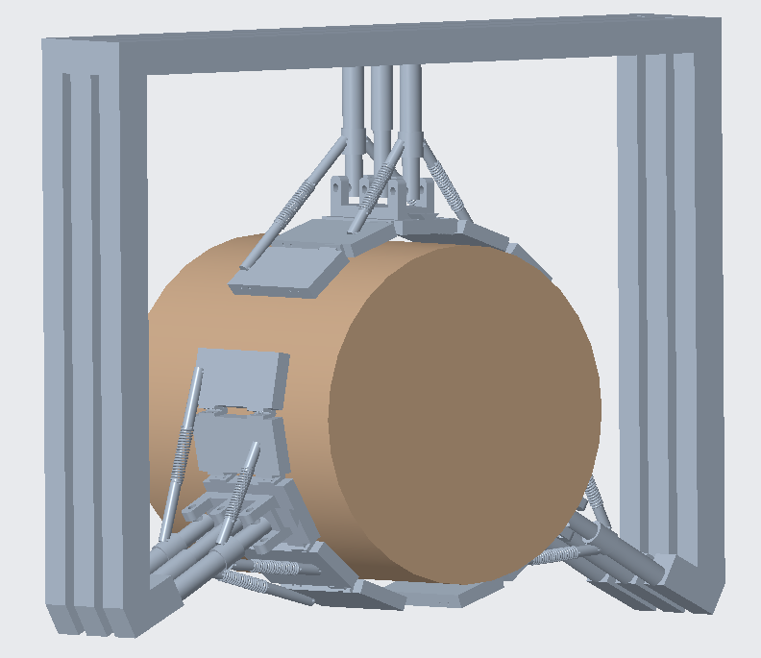
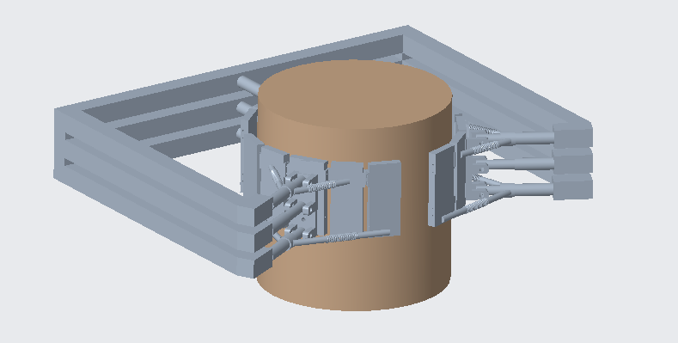
Final Design Configuration
NOT TO SCALE
Charles Stubbs
Departments of Mechanical Engineering and Industrial Engineering
Notes:
Here is the final design configuration in a CAD model that we are going to move forward with. As you can see there are multiple pads for each gripper finger and the links are static except for the linear motion in and out of the part’s axis. The chassis would be as indicated but these proportions and geometries are not finalized but are there to demonstrate the concept configuration.

Slide 17
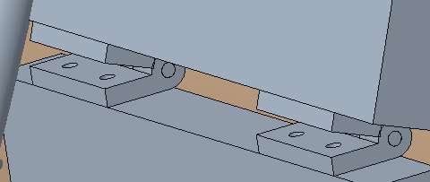
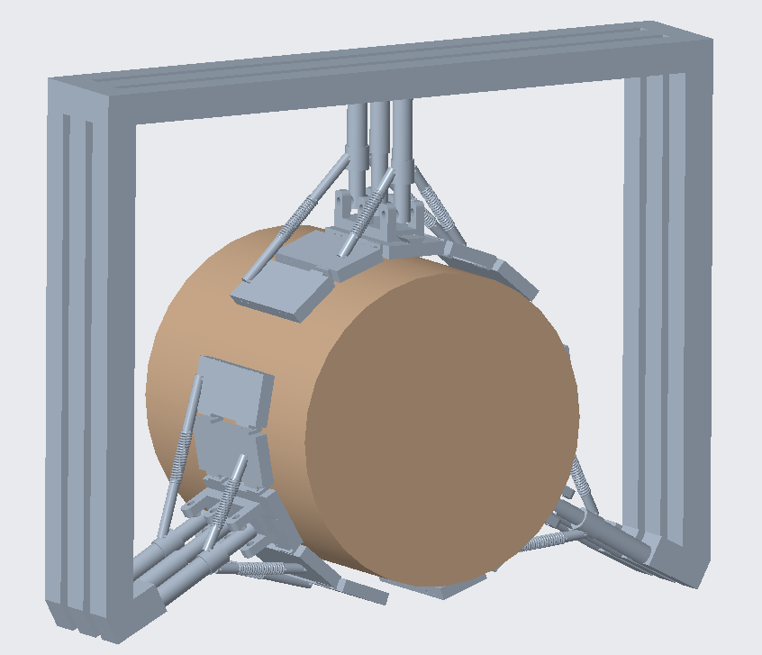
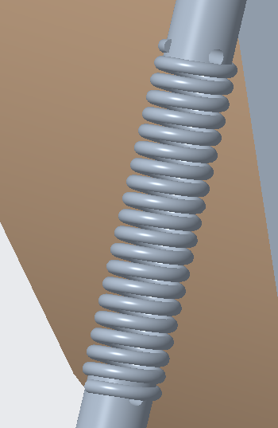
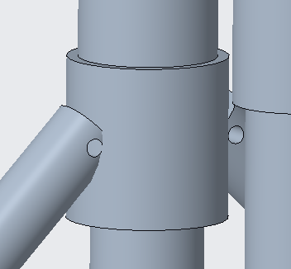
Functional Diagram
Linear actuators move normal to part surface
Sleave bearing hinges support gripper load
Compressive springs allow adaptation to part surface
Adjustable collar reacts spring forces
NOT TO SCALE
Charles Stubbs
Departments of Mechanical Engineering and Industrial Engineering
Notes:
This functional diagram includes the primary changes for this design configuration. The linear actuators are included here. These will move the gripper in and out normal to the part surface. There are guiding rods to accommodate and provide support in the linear motion. These support each of the pads via the spring mechanism connecting them. These springs would compress as the flaps engage with the part or they could press out as the grippers move forward to contour to the part surface. There are adjustable collars to transmit the spring forces along the supporting rods. Joining each of the flaps are hinges to support loading while permitting motion. These could stick out in front of the flaps but the padding will be cut at the joints to keep this from being an issue. The flaps could be removed for different sizes or configurations.

Slide 18
Sequence Diagram
Software
I/O
Hardware
Monitor incoming data over Serial
Monitor force sensor data
Receive information and process
Send information to microcontroller
Transduce force data
Monitor incoming data over Serial
Monitor actuator position data
Receive information and process
Send information microcontroller
Potentiometer reads linear position
Driver feedback position
Set output position signal
Inform linear actuator
Motors actuates from driver output
Monitor for incoming signals
Charles Stubbs
Departments of Mechanical Engineering and Industrial Engineering
Notes:
We put together a high level electronic sequence diagram to illustrate the logical flow for each sequence of the gripper engagement. The software will be monitoring for incoming data this includes the force sensor data first to see the degree of forces on the central pad. The sensor transduces force data then sends the data over, then the process is repeated for the linear actuator position data where the motor driver will also be independently regulating the position data. The Microcontroller will set the output signal which will inform the linear actuator and the motors will actuate accordingly. At the end of the sequence the microcontroller will be monitoring for any additional data like debug or other sensors.

Slide 19
Design Analysis
Use kinematics to define proportions and dimensions
Select springs and design mechanism to improve gripper contour to parts’ circumference
Select materials for structural loading and padding from static and dynamic system analysis
Charles Stubbs
Departments of Mechanical Engineering and Industrial Engineering
Notes:
For the continued analysis in the developing design, we are using kinematics to continue to iron out the final dimensions and drawings for the mechanism and part selection. Making a 3d prototype for the final design configuration just like the prior design to help with this process. We will follow this on by selecting the springs and designing that mechanism to get a good contour for the parts’ surface. We are also continuing to select materials for the padding and the different structural members and materials through the dynamic and static loads analysis.

Slide 20
Testing and Evaluation
Preliminary testing to verify electrical and software system functionality
Implement a test encompassing the validation of each target
Create test fixture accommodating full vertical and horizontal motion
Ensure safety and data collection fidelity during test procedure
Charles Stubbs
Departments of Mechanical Engineering and Industrial Engineering
Notes:
We will conduct preliminary testing on the functionality of the electrical and software systems and collect data to establish a baseline. This will also serve to help root out any mechanical errors or software bugs in the design. At this stage we will also be calibrating the various sensors. We will continue by implementing a test that will encompass all the validation methods for each target. The data will also be collected to measure the degree to which it meets the targets. Later in the semester we will be designing a test fixture to accommodate all of the sizes of cylinders and impart the require vertical and horizontal motions. Throughout all of this we will be ensuring the safety and data collection fidelity during the test procedure. This will be approached through a test manual or procedure for the operation

Slide 21
Future Work
Order Materials/Parts
Assembly and Fabrication
Project Testing
Electrical and Software Design
Charles Stubbs
Departments of Mechanical Engineering and Industrial Engineering
Notes:
Looking forward, we are going to order our materials and parts based on our finalized design and analysis, as soon as we have ironed out the important dimensions and components. Once the parts come in, we will begin the assembly of the system. This will involve some fabrication given the current state of the design which will likely take a long time. These components thus must be ordered soon and while they are being shipped and fabricated we will work on the electrical and software design. Once the system is complete, we will begin testing our proof of concept using the samples we were given. Throughout these processes, we will allot for error in electrical and software design such as sensor calibration and coding and consistently work to ensure consistency. Fixes may be implemented after successful test conduct.

Slide 22
Thank You
Makada Browne
Erich Noack
Charles Stubbs
Amelia Veith
msb16f@my.fsu.edu
ean18f@my.fsu.edu
ces17f@my.fsu.edu
afv17@my.fsu.edu
Departments of Mechanical Engineering and Industrial Engineering

