Slide 1
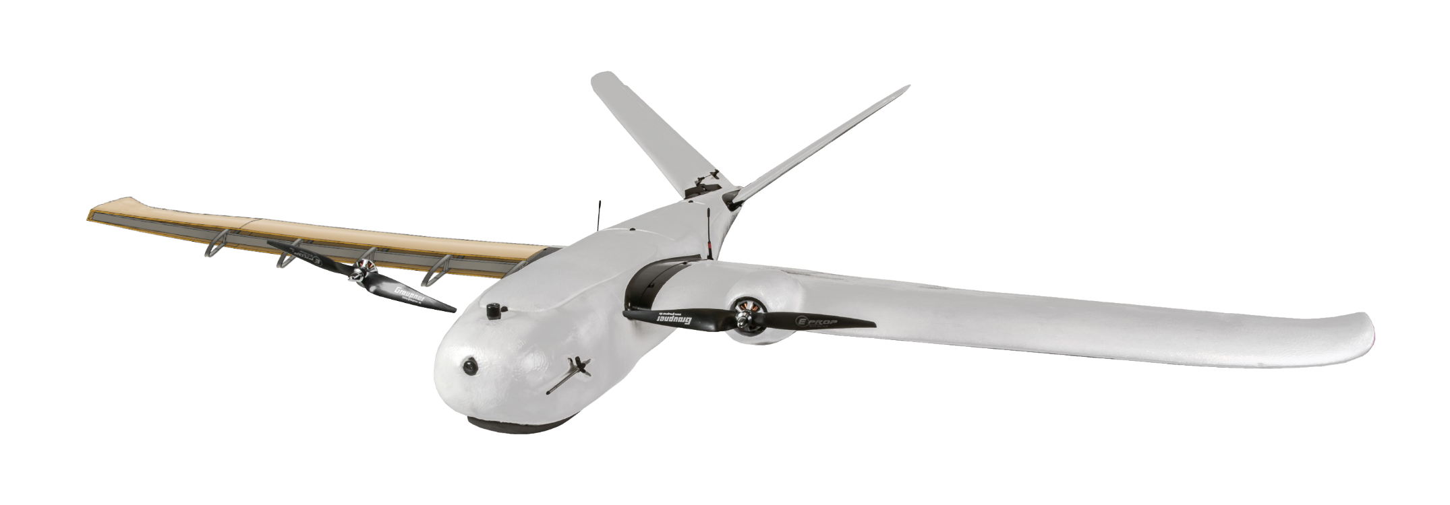
Lightweight UAV
Team 518
Clayton Cooley, Taylor Jacobs, Zachary Noay, Brenden Richman, Brian Thervil

Slide 2
Team Introduction
Zachary Noay
Embedded Systems Engineer
Electrical Engineering
Clayton Cooley
Test Engineer
Mechanical Engineering
Taylor Jacobs
Flight Dynamics Engineer
Mechanical Engineering
Brenden Richman
CAD/Materials Engineer
Mechanical Engineering
Brian Thervil
Software/System Integration Engineer
Electrical Engineering

Slide 3
Sponsor and Advisor
A global security company that provides innovative solutions worldwide.
Dr. Rajan Kumar
Jennifer Tecson
Research in Aerodynamics, Experimental Fluid Mechanics, and Flow Diagnostics
Taylor Jacobs

Slide 4
Project Objective
The objective of this project is to reduce the weight of a commercially available UAV through light-weighting processes.
Taylor Jacobs

Slide 5
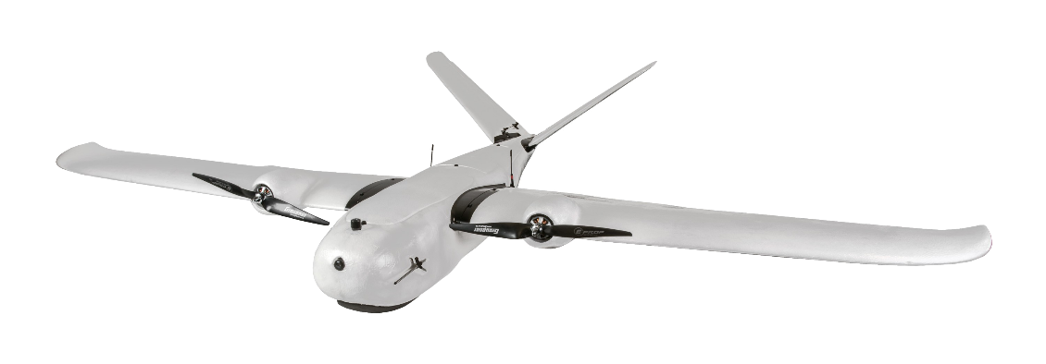
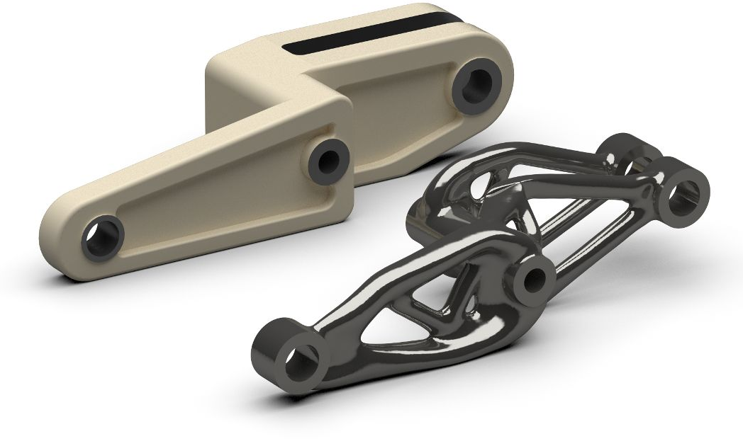
Project Summary
Narrowed down the project scope
Lighten and optimize a commercial fixed wing UAV
Match or improve original UAV parameters
Select a commercial drone
Believer 1960mm
Determine methods of light-weighting
Generative Design
Multi-use Components
Begin designing and planning
Believer 1960mm
Taylor Jacobs

Slide 6
Generative Design
Wing support for small sections
Problematic for following shapes
Use for supports and mounts in fuselage
Taylor Jacobs

Slide 7
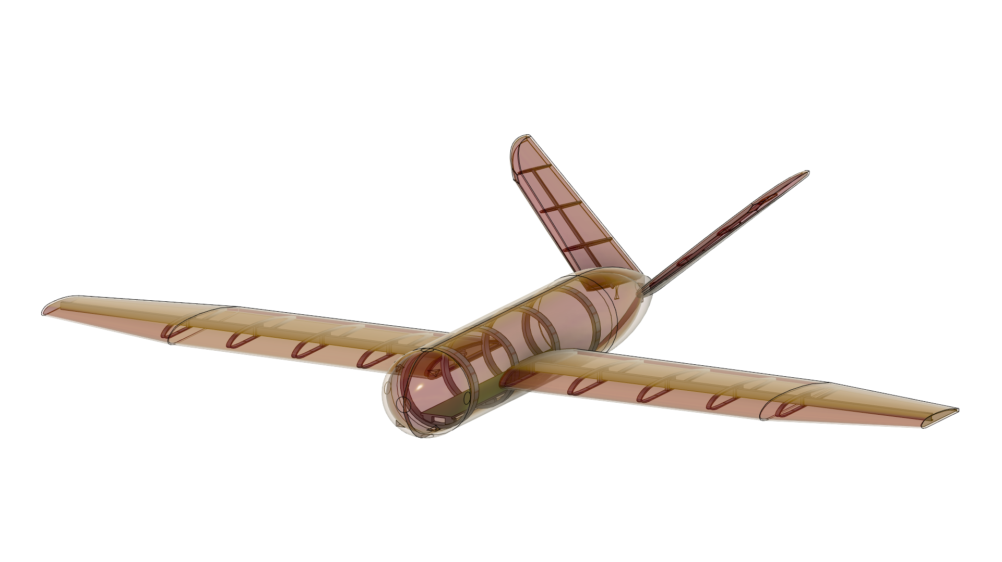
CAD Designs
All body components created
Ribbed support structure
Weight estimations calculated
Taylor Jacobs

Slide 8
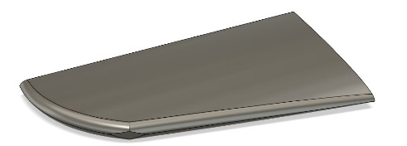
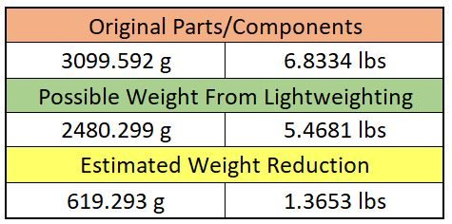
Weight Savings
Taylor Jacobs

Slide 9
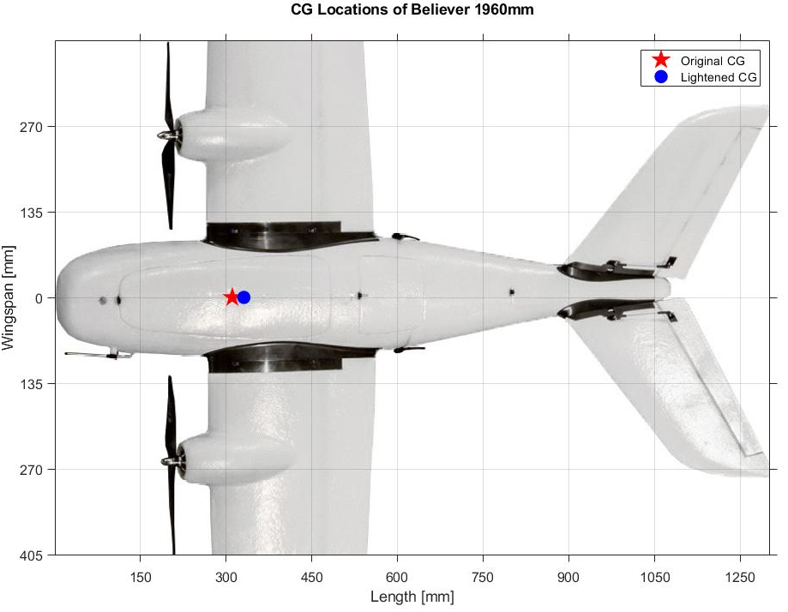
Effects on Flight
Changes stability of flight
Lift and drag changes
Can be fixed with component placement
Taylor Jacobs

Slide 10
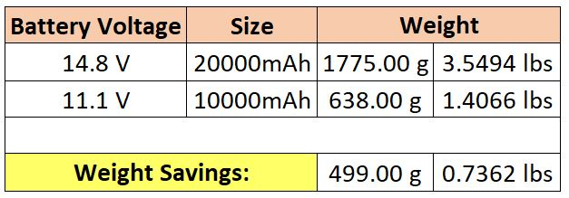
Thrust Changes
Thrust calculations at full throttle
Weight reduction changes max thrust requirement
Battery adjustment achieves required thrust
Taylor Jacobs

Slide 11
Prototyping
Taylor Jacobs

Slide 12
3D Skeletons
Printed PLA wing skeletons (Scaled down to 50%)
Individual ribbed sections
Connected with C-channel
Low structural integrity
Brenden Richman

Slide 13
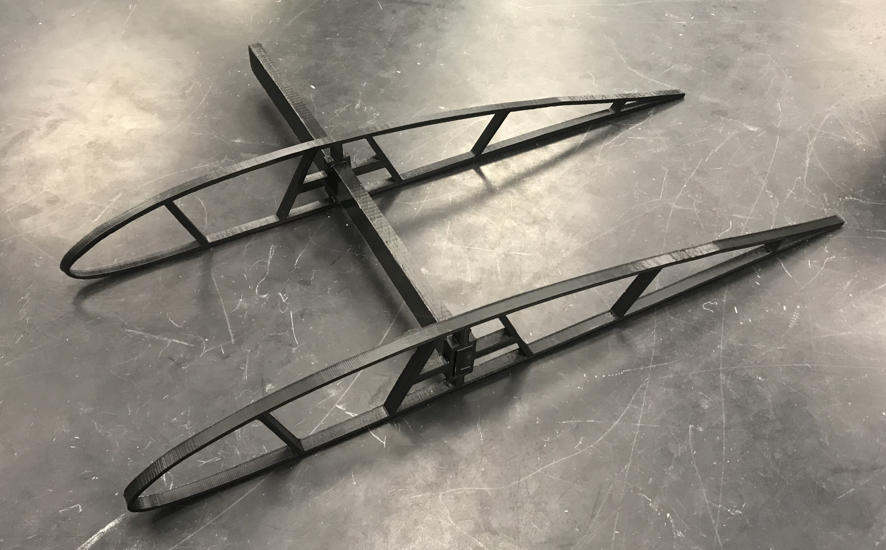
3D Skeletons
Eventually printed in Light-weight PLA
Modeled to scale
Structural supports added
When implemented, covered with foam
Brenden Richman

Slide 14
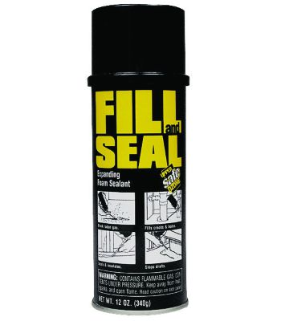
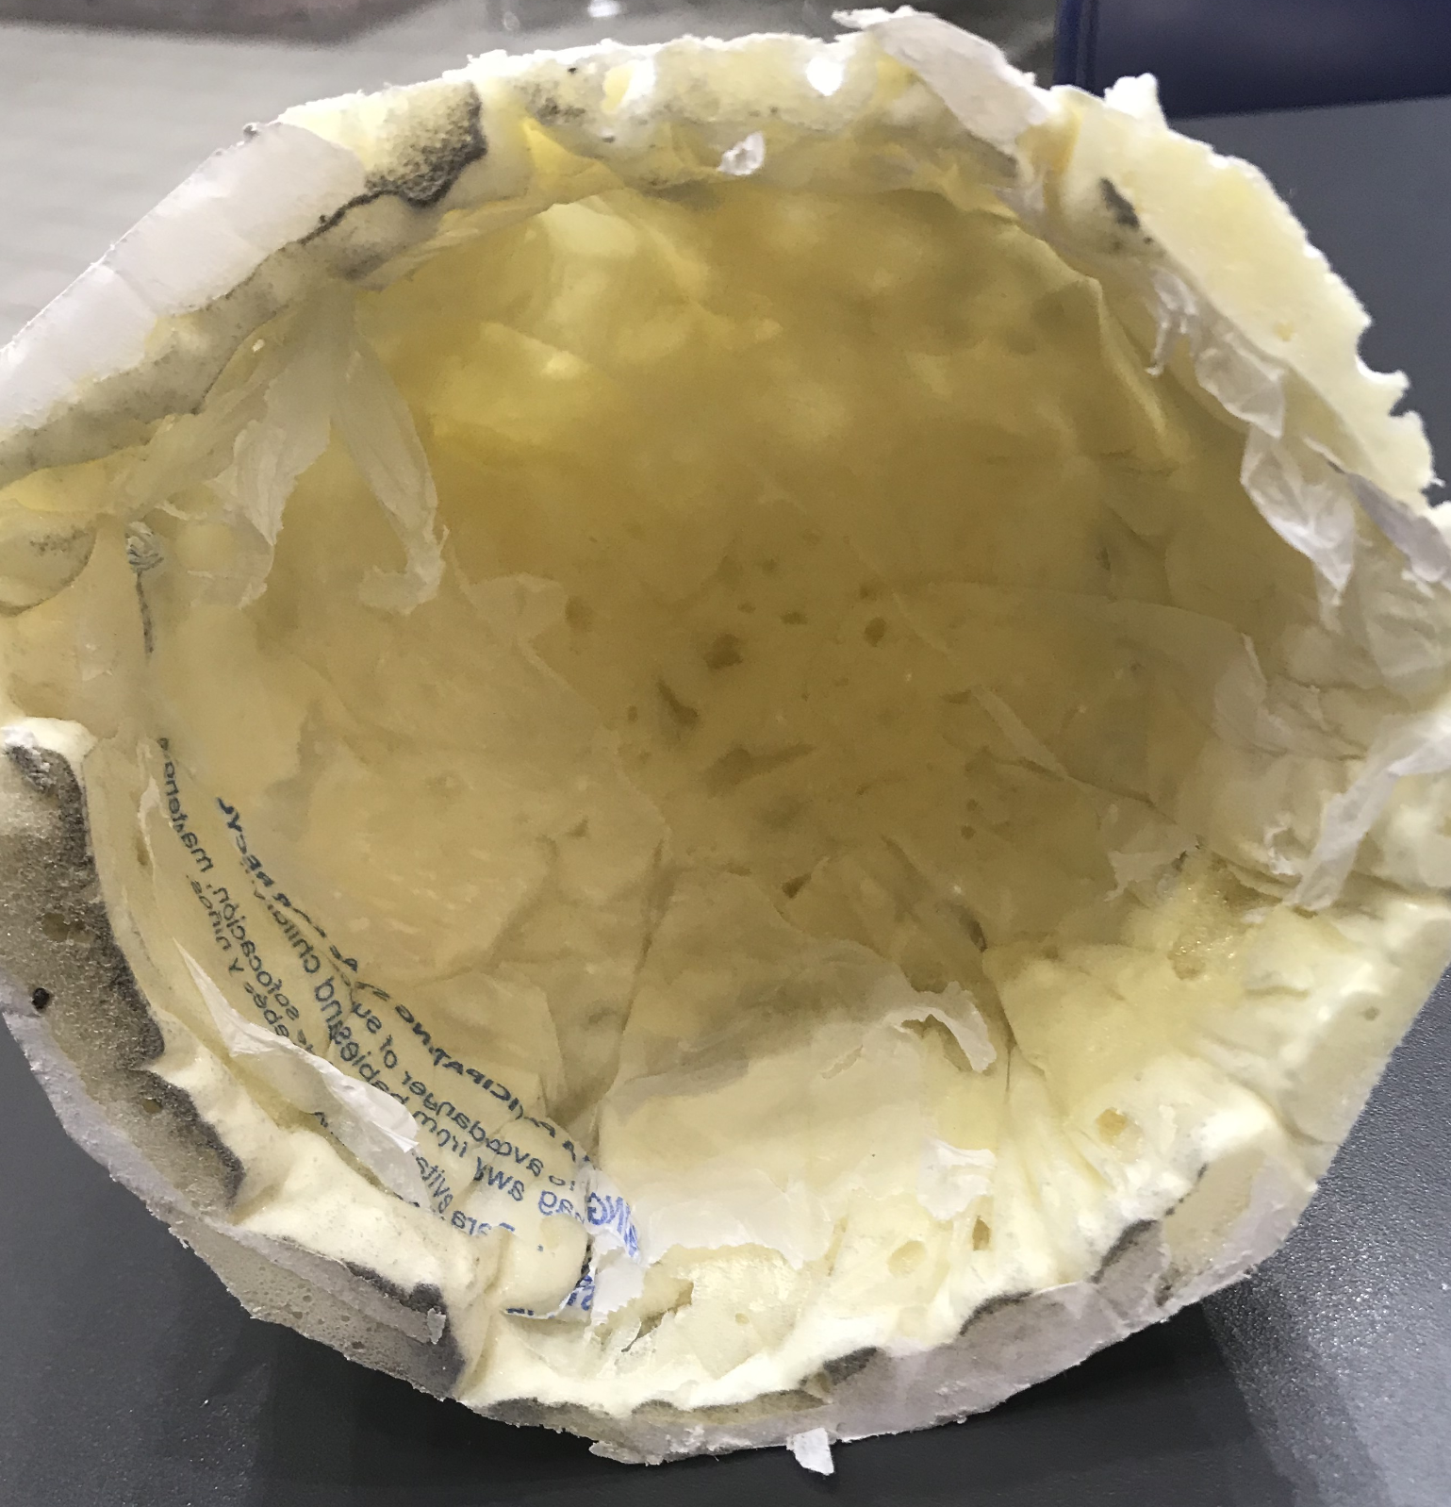
Expanding Foam
Initial Tests done with Fill and Seal foam (up to 3x expansion)
Foam tends to stick to mold
Brenden Richman

Slide 15
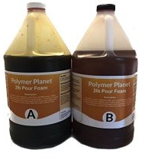
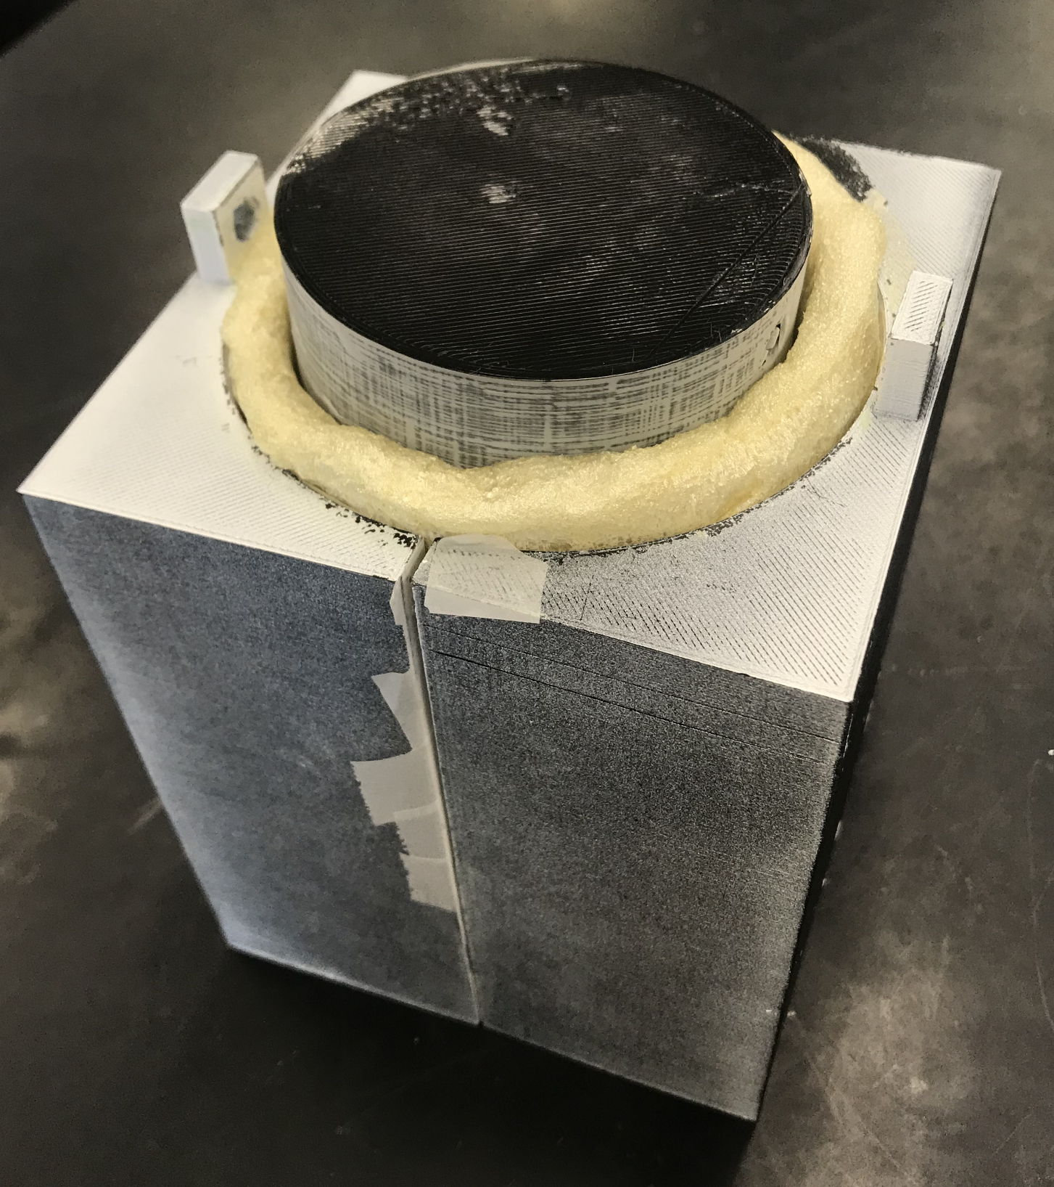
Polyurethane Foam
2-Part Solution
Up to 25x expansion
Molded using a pour over, casting method
Inner and Outer shell
Scaled down mold (60% actual size)
Brenden Richman

Slide 16
Polyurethane Foam
Epoxy-paint + Wax (Outside)
Paint sticks due to reaction heat
Wax has little effect
Poor surface finish (open cell)
Can be sanded and painted
Adds weight
Saran Wrap (Inside)
Very wrinkly surface
Sticks to foam
Brenden Richman

Slide 17
Polyurethane Foam
Packing Paper (Outside)
Easy release from mold
Paper and masking tape sticks
Improved surface finish
Wax Paper (Inside)
Easy release from mold
Completely sticks to foam
Wrinkly finish
Brenden Richman

Slide 18
Polyurethane Foam
Scotch Tape (Outside + Inside)
Foam doesn’t stick to polypropylene
Easy release from mold
Small wrinkles
Best surface finish (closed cell)
Could be improved with packing tape
Brenden Richman

Slide 19
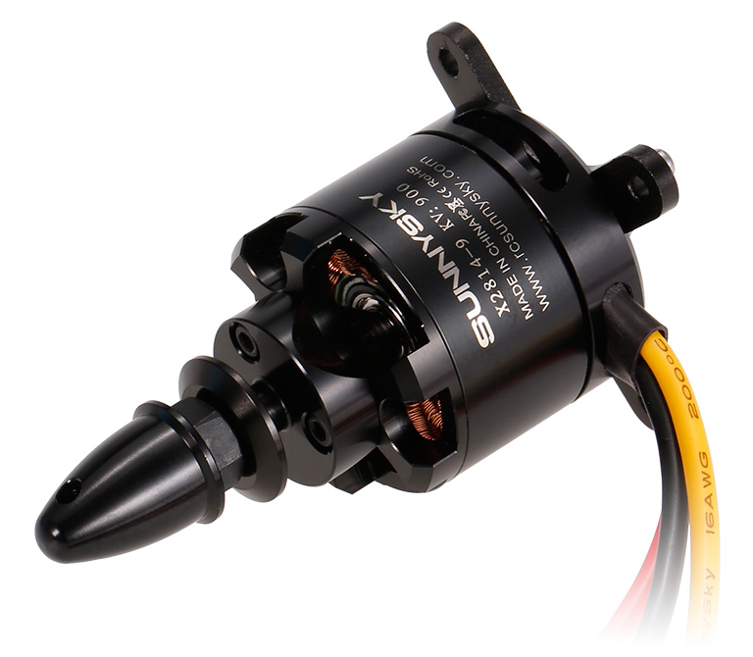
Future Work
Complete prototype body
Test electrical systems
Servos, controller, remote, etc...
Finish weighing and dimensioning body pieces
Improve calculation accuracy
Begin LW-PLA printing of skeleton
Foam molding of wing exterior
Brenden Richman

Slide 20
References
Staples, G. (2013, July 16). Propeller Static & Dynamic Thrust Calculation. Retrieved from https://www.electricrcaircraftguy.com/2013/09/propeller-static-dynamic-thrust-equation.html
T, G. (2005, March 04). What Doesn't Expanding Foam Stick To? Retrieved from RC Groups: https://www.rcgroups.com/forums/showthread.php?341842-What-DOESN-T-expanding-foam- stick-to/page2

Slide 21
Questions
Team 518
Clayton Cooley, Taylor Jacobs, Zachary Noay, Brenden Richman, Brian Thervil

Slide 22
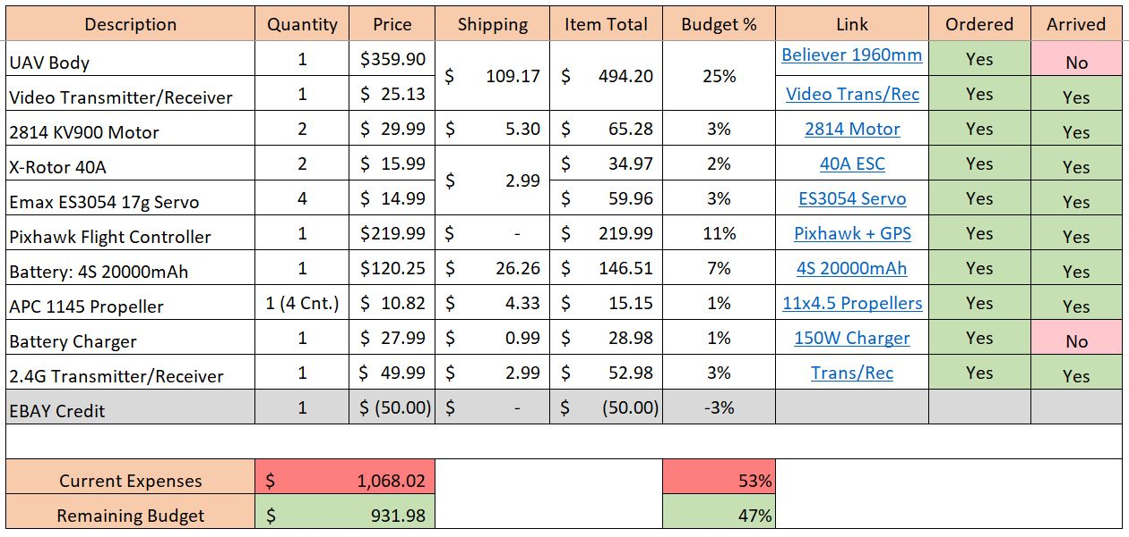
Budget

Slide 23
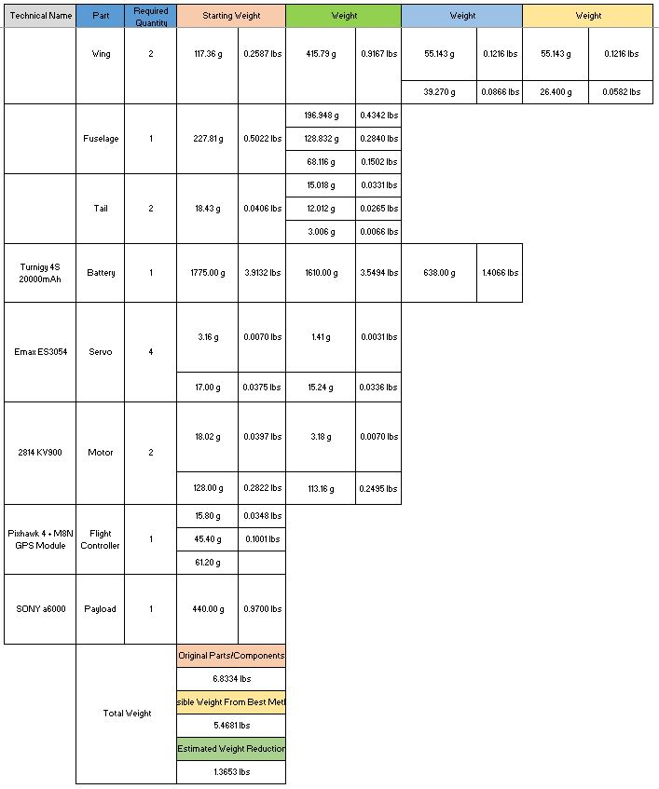
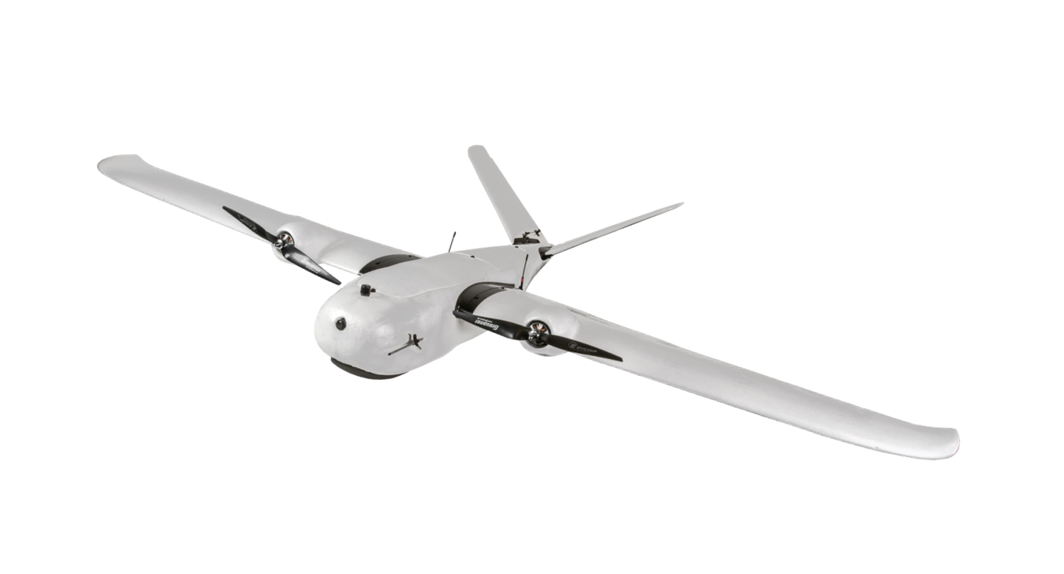
Full Weight Savings

Slide 24
Force Analysis
Stress
Displacement

Slide 25
Contact Pressure
Strain

