Slide 1



Portable Kit for Alkaline Membrane Fuel Cell (AMFC)
Team
------------------------------
Nicole Alvarez
Bryan Anderson
Collin Heiser
Mustafa Nek
James Richardson
Advisor: Juan Ordonez,
Jose Vargas
Sponsor: FIPSE
Group 10

Slide 2
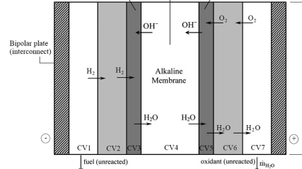
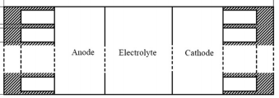
What is an Alkaline Membrane Fuel Cell
Four Main Components
  Anode
  Cathode
  Membrane
  Bipolar Plates
Advantages
  No environmental pollutants
  Higher Current Density
  Organic Membrane used
Basic Schematic of an AMFC
Group 10 Collin Heiser
Slide 2 of 14 Portable Kit of AMFC

Slide 3
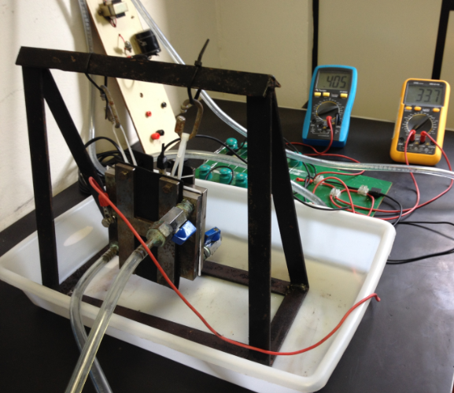
Project Overview
We are designing a portable AMFC with custom specifications to meet our particular application
Helping to prove the effectiveness of the organic cellulose membrane and KOH
This will be done by taking the existing research as a base for introducing some of the new ideas we will be implementing
Existing AMFC in Brazil
Group 10 Collin Heiser
Slide 3 of 14 Portable Kit of AMFC

Slide 4
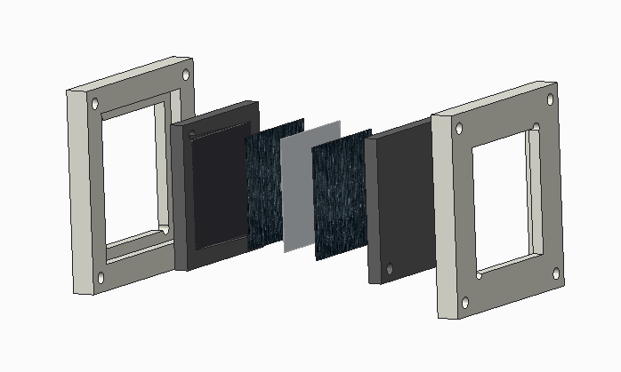
Exploded View
Group 10 Collin Heiser
Slide 4 of 14 Portable Kit of AMFC

Slide 5
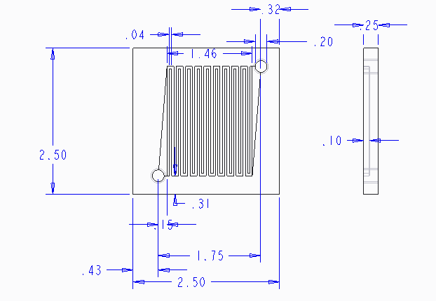
Bipolar Plate Drawing
Group 10 Collin Heiser
Slide 5 of 14 Portable Kit of AMFC

Slide 6
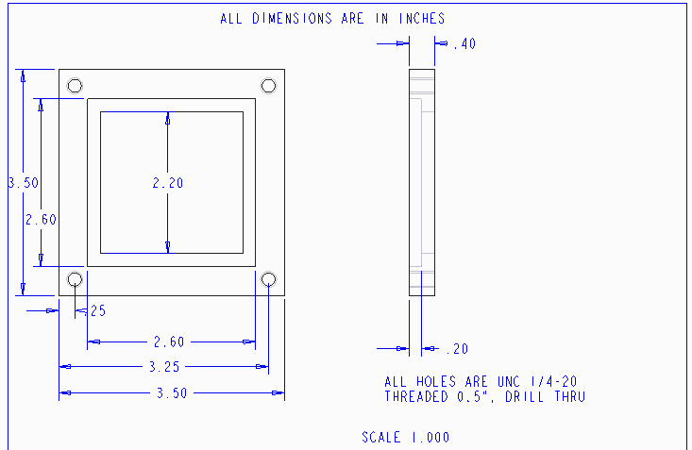
Mounting Bracket Drawing
Group 10 Collin Heiser
Slide 6 of 14 Portable Kit of AMFC

Slide 7
Material Selection
Completed
Awaiting Completion
  Fuel Delivery System
  Casing for Educational Kit
  Observable Output using Generated Power
  Operation and Safety Manual
Group 10 James Richardson
Slide 7 of 14 Portable Kit of AMFC

Slide 8
Effects of Sizing
Limitations on Size without wasting materials
Some material costs remain constant
20% Platinum concentration electrode
    20 cm x 20 cm
40% Platinum concentration electrode
    19 cm x 19 cm
Benefits/Drawbacks
    $2.68 difference in cost
    Increase in efficiency
    Decrease in operational area
Model of cost increase with increasing Fuel Cell Operational Area
Group 10 James Richardson
Slide 8 of 14 Portable Kit of AMFC

Slide 9
Testing of the Cell
Determining the polarization curve of the cell
Endurance test
  Test the duration that the cell can run before failure
Membrane Durability testing
  Increase the pressure on a fully used membrane until failure
Group 10 Collin Heiser
Slide 9 of 14 Portable Kit of AMFC

Slide 10
Future Plans
Machining and creating a functioning cell
  Machining will start on 02/23/2015
Ensure we have a gas system that is portable and meets DOT standards
  In contact now with a supplier
Perform the needed tests on the fuel cell
  Testing can begin 3/02/2015
Order the necessary casing to ensure the cells portability
Group 10 Collin Heiser
Slide 10 of 14 Portable Kit of AMFC

Slide 11



Updates from UFPR
Larissa Villar & Leonardo Oliveira
Arriving on April 6th, 2015
Open House
Operation and Safety Manual
Group 10 James Richardson
Slide 11 of 14 Portable Kit of AMFC

Slide 12
Challenges Faced
Working between two Nations
  Communication
  Differing Technologies
Need of some specialty products
  Vendors
Unreasonable to form a prototype
  Constrained by Materials
Group 10 James Richardson
Slide 12 of 14 Portable Kit of AMFC

Slide 13
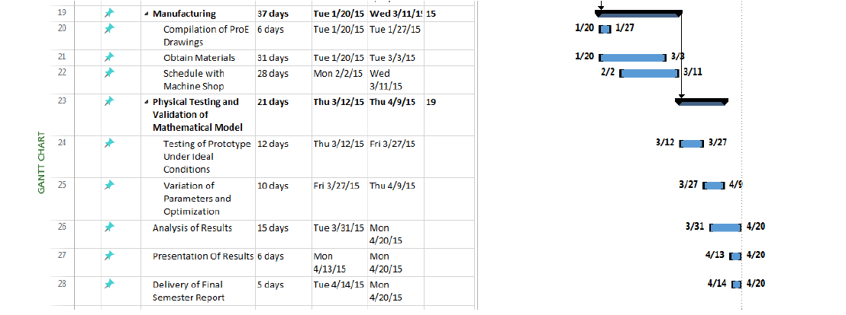
Gantt Chart
Group 10 James Richardson
Slide 13 of 14 Portable Kit of AMFC

Slide 14
Questions
Group 10 Slide 14 of 14 Portable Kit of AMFC

