Slide 1



EML 4551C SENIOR DESIGN
DR. KAMAL AMIN
TEAM 4: ALTERNATE MATERIAL SELECTION FOR COMPRESSOR CASING IN TURBOCHARGER
MIDTERM I: CONCEPT DEVELOPMENT PRESENTATION
Group Members alexander Mankin
HARRISON MCLARTY
Ralph Scott
Abiodun OLUWALOWO
Project sponsor AND FACULTY Adviser
Cummins - Roger England
DR. PETER KALU
24 OCTOBER 2013

Slide 2
Outline
Project Scope
Project Background
Project Objectives
Design Concepts and Evaluation
Potential Challenges and Risks
Brief Future Plans Outline
Gantt Chart
Final Summary
References
Questions

Slide 3
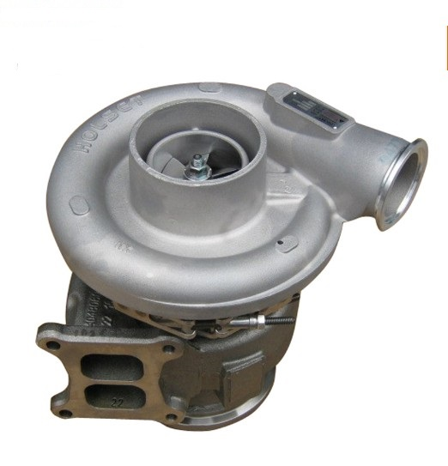
Project Scope
Cummins has an interest in researching and selecting alternate materials to fabricate compressor casings in their B series turbochargers
This alternate material should ultimately be more cost effective than the current one in use, cast aluminum 356, and still satisfy the design and operational parameters set by Cummins
Fig.1: View of turbocharger.[5]
Estimates of manufacturing costs for this alternate material and 3 full scale prototypes are key requirements
Ralph Scott

Slide 4
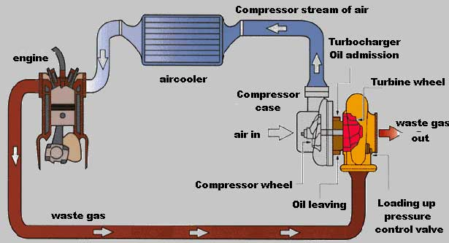
Project Background
Figure 1. Schematic of how a turbocharger operates
Ralph Scott

Slide 5
Project Background cont.
A cost efficient material which could replace cast aluminum 356 presents many beneficial opportunities for Cummins
The revenue gained from more cost efficient materials and manufacturing processes present financial advantages for Cummins
Production numbers on compressor casings and turbochargers have the potential to grow allowing the company to meet and exceed the expectations of customers
Ralph Scott

Slide 6
Project Objectives
Determine the temperatures, pressures, and stresses experienced by the compressor during operation
Research and compare materials which can operate under these prescribed physical conditions, and are cheaper both as a material and to manufacture
Estimate manufacturing costs with this new material and compare it to cast aluminum 356, which is currently used to fabricate the casings
With the known operational conditions and alternate material known, utilize Finite Element Analysis in conjunction with a CAD model of the casing for analysis
Obtain three prototypes of these casings for testing and experimentation
Ralph Scott

Slide 7
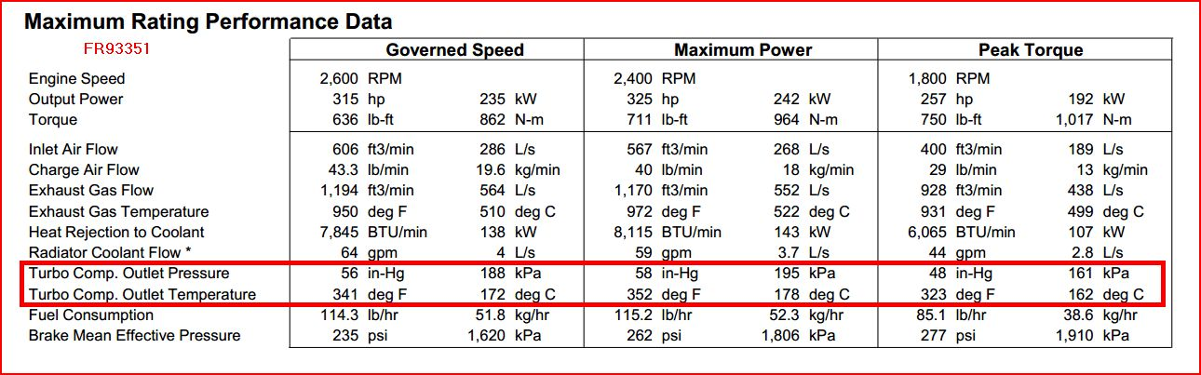
Design Concepts
Operational Conditions for Compressor
Figure 2. Experimental data of turbocharger supplied by sponsor
Ralph Scott

Slide 8
Design Concepts cont.
Design Specifications
Casing must possess the same design and geometric tolerances currently in place on the compressor in Cummins turbocharger
Alternate material must be able to safely and continuously operate at temperatures up to 230$℃$
Also, based on the data provided by the sponsor, the casing should be able to withstand pressures up to 215 kPa
Ralph Scott

Slide 9
Design Concepts cont.
Performance Specifications
Material must be able to withstand cyclic temperatures including below freezing atmospheric conditions
Compressor casing must be able to withstand and contain a catastrophic failure of the compressor blades caused by over boosting, without fracturing
Corrosion resistance is also an important requirement due to the presence of oil, dirt, water, engine coolant, salt, and other chemicals during the operation of an automobile
Ralph Scott

Slide 10
Design Concepts cont.
Why replace the current Aluminum alloy?
Reduce the overall cost of production with a cheaper alternative
Reduce the overall operating cost
Reduce the weight of the casing
Ralph Scott

Slide 11
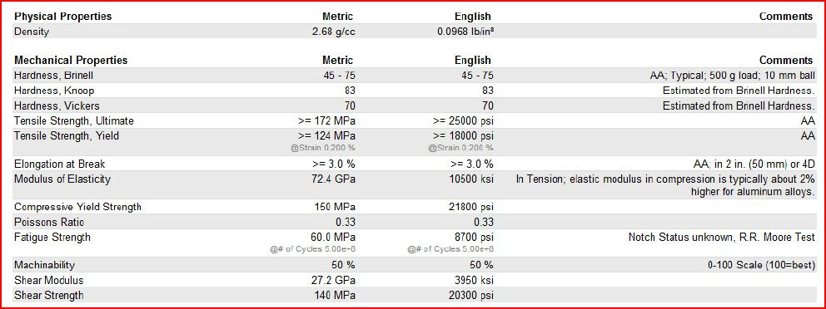
Design Concepts cont.
Figure 3. Properties of cast aluminum 356. (3)
Ralph Scott

Slide 12
Design Concepts cont
Possible Material Candidates
Polymers
Thermoplastics
Thermosetting Plastics
Fiber-Reinforced Polymers(FRP)
Ceramics
Ceramic Matrix Composites(CMCs)
Metals
Magnesium
Metal Matrix Composites(MMCs)
Alex Mankin

Slide 13
Design Concepts cont.
Aluminum 356
Extem UH
Tensile Strength, Yield: >= 124 MPa
Elongation @ Break: >= 3.0%
Hardness, Brinell: 45-75 (500g 10mm ball)
Solidus/ Max Operating Temp.: 557°C
Machinability: 50% (from 0-100)
Tensile Strength, Yield: 120 MPa
Elongation @ Break: 19-20%
Izod Impact: .750 J/cm
Continuous Operating Temp.: 230°C
Machinability: N/A
Deflection Temp. (264 psi): 231°C
Alex Mankin

Slide 14
Design Concepts cont.
Extem UH
Advantages
Limitations
Can Operate at the required 230°C max temperature
Performs well below 0 to 230°C
Highly chemical resistant
Tensile strength is almost equal to that of aluminum 356
Unknown cost of the material
At any temperatures higher than 257°C it will start to soften
Will require a different manufacturing method than that of the aluminum
Alex Mankin

Slide 15
Design Concepts cont.
Aluminum 356
Fluorosint 500
Tensile Strength, Yield: >= 124 MPa
Elongation @ Break: >= 3.0%
Hardness, Brinell: 45-75 (500g 10mm ball)
Solidus/ Max Operating Temp.: 557°C
Machinability: 50% (from 0-100)
Tensile Strength, Yield: 7.58 MPa
Elongation @ Break: 30%
Izod Impact: .481 J/cm
Continuous Operating Temp.: 260°C
Machinability: 2 (from 1-10)
Deflection Temp. (264 psi): 132°C
Alex Mankin

Slide 16
Design Concepts cont.
Fluorosint 500
Advantages
Limitations
Can operate at a continuous temperature of 260°C
Has a thermal expansion rate close to aluminums
Non-abrasive to most mating materials
Good wear characteristics
Easy to machine
Much lower Tensile strength compared to aluminum 356
High cost estimate
Currently can only be ordered in thin sheets or tubes
Will require a different manufacturing method due to shape of material available
Alex Mankin

Slide 17
Design Concepts cont.
Aluminum 356
PEEK - 30% Carbon-Filled
Tensile Strength, Yield: >= 124 MPa
Elongation @ Break: >= 3.0%
Hardness, Brinell: 45-75 (500g 10mm ball)
Solidus/ Max Operating Temp.: 557°C
Machinability: 50% (from 0-100)
Tensile Strength, Yield: 186 MPa
Elongation @ Break: 1.1%
Izod Impact: .481 J/cm
Continuous Operating Temp.: 260°C
Machinability: N/A
Deflection Temp. (264 psi): 316°C
Alex Mankin

Slide 18
Design Concepts cont.
PEEK - 30% Carbon-Filled
Advantages
Limitations
Can operate at a continuous temperature of 260°C
Excellent impact, and tensile characteristics
Exceptional chemical resistance
Outstanding wear and abrasion resistance
Low smoke and toxic gas emissions
Is the most brittle of the materials with a elongation of only 1.1%
May be more difficult to machine due to its brittleness
Alex Mankin

Slide 19
Design Concepts cont.
Aluminum 356
Rulon 945
Tensile Strength, Yield: >= 124 MPa
Elongation @ Break: >= 3.0%
Hardness, Brinell: 45-75 (500g 10mm ball)
Solidus/ Max Operating Temp.: 557°C
Machinability: 50% (from 0-100)
Tensile Strength, Yield: 20.7 MPa
Elongation @ Break: 20%
Izod Impact: N/A
Continuous Operating Temp.: 288°C
Machinability: N/A
Deflection Temp. (264 psi): N/A
Alex Mankin

Slide 20
Design Concepts cont.
Rulon 945
Advantages
Limitations
Can operate at a continuous temperature of 288°C
Low deformation under load and high impact resistant
Excellent abrasion and corrosion resistance
A low Tensile Strength to that of aluminum
Will require a different manufacturing method than that of the aluminum
Alex Mankin

Slide 21
Potential Challenges and Risks
Running into cost issues with any of the materials we choose
Finding a Machinist or company that would be willing and able to machine a prototype compressor casing out of the material we eventually decide on
Once the prototype is made, having it put under proper testing to evaluate its performance
Alex Mankin

Slide 22
Future Plans
Final selection of material
Prototyping and testing
Determine type of manufacturing process
Determine cost for material and manufacturing process
Alex Mankin

Slide 23
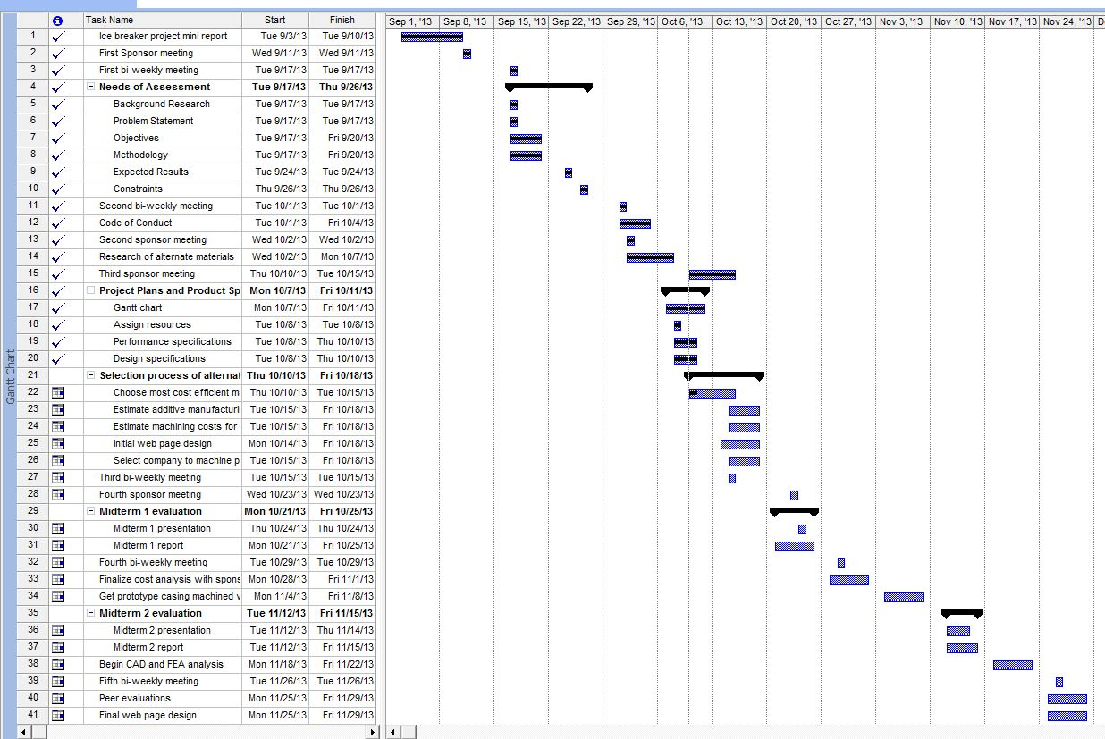
Gantt Chart
Alex Mankin

Slide 24
Final Summary
Our task is to come up with an alternative material for a turbocharger compressor casing
Using the operating conditions provided to us by Cummins we can determine which materials are suitable
We have researched many different materials that met our criteria
We found that polymers were the best option to reduce cost and weight
No choice yet, more research is needed
Alex Mankin

Slide 25
References
1. "Turbo Torque." Turbo Torque. N.p., n.d. Web. 21 Oct. 2013. <http://www.mazdarotary.net/turbo.htm>.
2. "Online Materials Information Resource - MatWeb." Online Materials Information Resource - MatWeb. N.p., n.d. Web. 21 Oct. 2013. <http://www.matweb.com/>.
3. "Plastic Sheet, Plastic Rod, Plastic Tubing - Buy Online." Plastic Sheet, Plastic Rod, Plastic Tubing - Buy Online. N.p., n.d. Web. 21 Oct. 2013. <http://www.professionalplastics.com/>.

Slide 26
Questions

